Slide 1


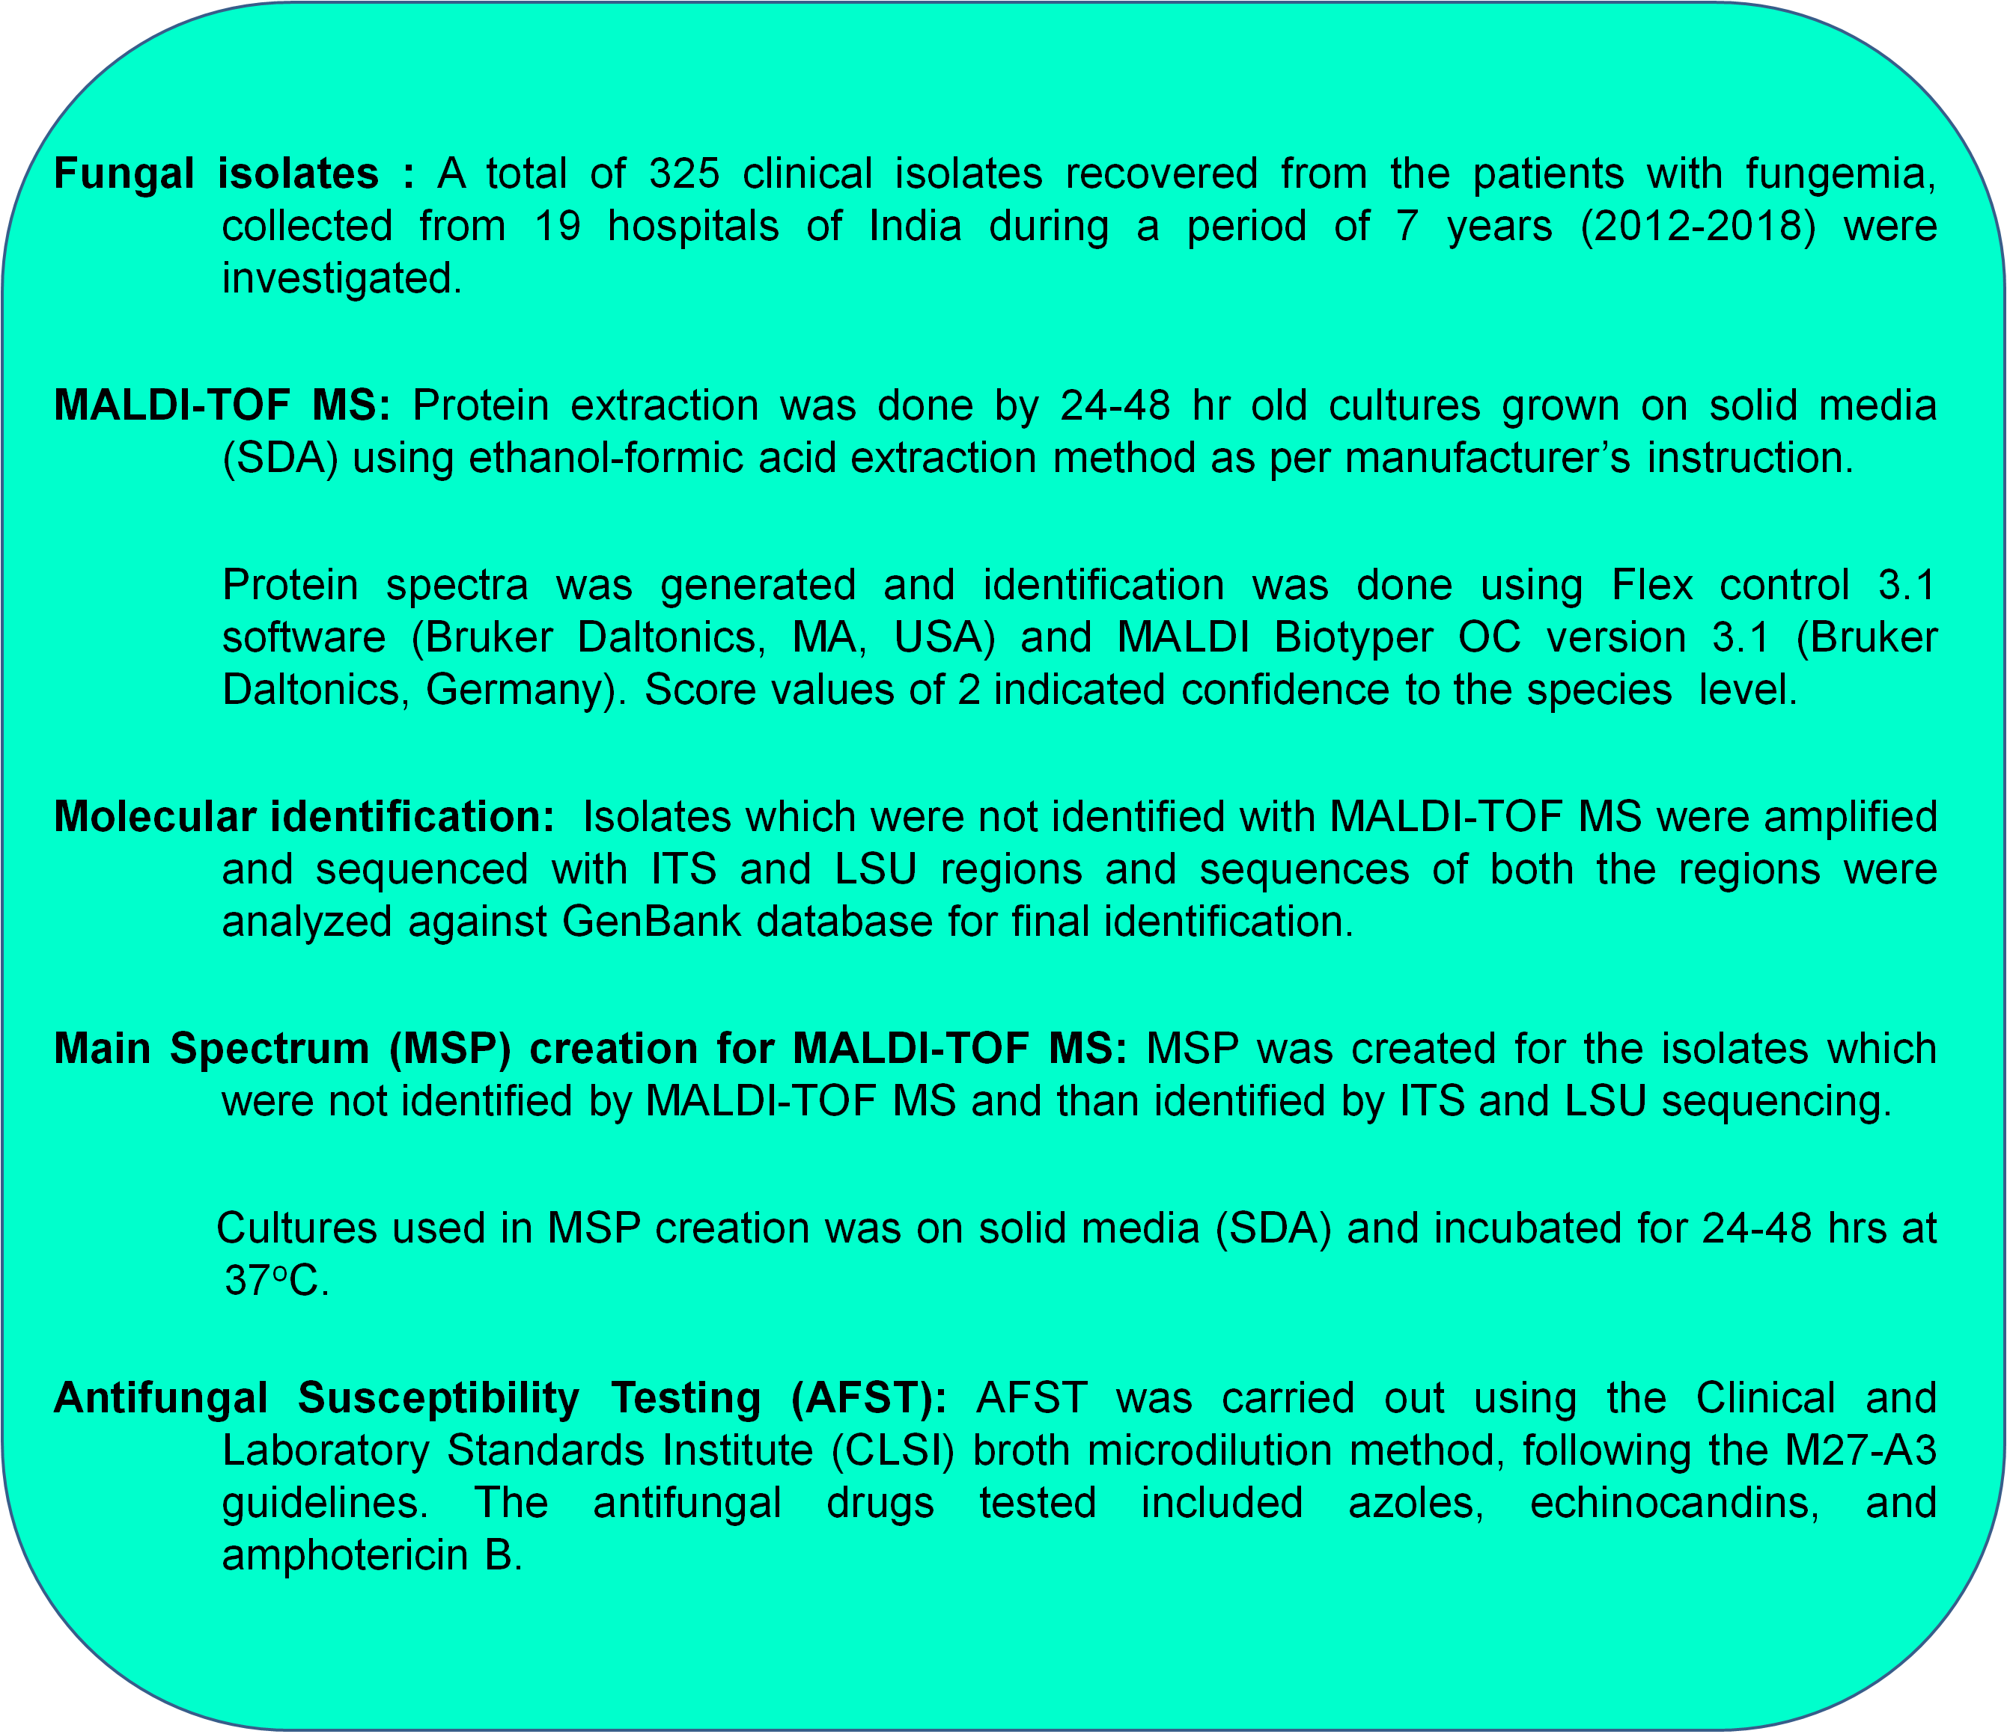
Antifungal resistance in rare opportunist yeasts causing fungemia: a laboratory based surveillance in Indian hospitals
AAR-679
Pradeep Kumar Singh, Vaishali Sharma, Ashutosh Singh, Anuradha Chowdhary
Department of Medical Mycology, Vallabhbhai Patel Chest Institute, University of Delhi, India
INTRODUCTION
Fungemia due to rare yeasts is an emerging clinical entity worldwide.
The potential risk of misidentification by conventional phenotypic methods, and the intrinsic resistance to certain classes of antifungal agents hampers effective clinical management of BSI due to rare opportunistic yeasts .
The present study aimed to determine the species distribution and antifungal susceptibility profile of rare yeasts in fungemia collected from 19 hospitals of India during a period of 7 years (2012-2018) was investigated.
Table: Antifungal susceptibility profile of 325 Yeast isolates originating from fungemia.
RESULTS
Organism | Drugs*
 | FLU | ITC | VRC | PSC | AMB | CAS | MFG | AFG
Candida krusei (n=122)
GM | 21.1 | 0.12 | 0.12 | 0.09 | 0.31 | 0.19 | 0.11 | 0.1
MIC₅₀ | 16 | 0.125 | 0.125 | 0.125 | 0.25 | 0.25 | 0.125 | 0.125
MIC₉₀ | 32 | 0.25 | 0.25 | 0.125 | 0.5 | 0.25 | 0.125 | 0.125
Range | 2-64 | 0.06-0.5 | 0.06-0.5 | 0.06-0.25 | 0.125-0.5 | 0.06-0.25 | 0.06-0.5 | 0.06-0.5
Trichosporon asahii (n=23)
GM | 0.78 | 0.43 | 0.04 | 0.08 | 4 | 2 | 1 | 1
MIC₅₀ | 0.5 | 0.06 | 0.03 | 0.06 | 2 | 0.5 | 0.25 | 0.25
MIC₉₀ | 1 | 0.5 | 0.03 | 0.25 | 16 | 4 | 2 | 2
Range | 0.125-16 | 0.03-1 | 0.03-1 | 0.03-0.5 | 16-Jan | 0.5-8 | 0.5-4 | 0.5-4
C. kefyr (n=23)
GM | 0.32 | 0.05 | 0.03 | 0.02 | 0.18 | 0.3 | 0.07 | 0.15
MIC₅₀ | 0.125 | 0.03 | 0.03 | 0.015 | 0.125 | 0.5 | 0.125 | 0.125
MIC₉₀ | 8 | 0.25 | 0.125 | 0.06 | 0.5 | 0.5 | 0.125 | 1
Range | 0.125-16 | 0.03-0.25 | 0.03-0.125 | 0.015-0.25 | 0.125-0.5 | 0.015-0.5 | 0.015-0.5 | 0.015-1
Pichia anamola (n=15)
GM | 13 | 0.29 | 0.25 | 0.47 | 1 | 0.47 | 0.47 | 0.47
MIC₅₀ | 16 | 0.25 | 0.25 | 0.5 | 1 | 0.5 | 0.5 | 0.5
MIC₉₀ | 16 | 0.5 | 0.25 | 0.5 | 1 | 0.5 | 0.5 | 0.5
Range | 2-16 | 0.25-0.5 | 0.25 | 0.25-1 | 1 | 0.25-0.5 | 0.25-0.5 | 0.25-0.5
C. duobushaemulonii (n=14)
GM | 6.72 | 0.27 | 0.07 | 0.1 | 16 | 0.13 | 0.38 | 0.54
MIC₅₀ | 8 | 0.25 | 0.125 | 0.125 | 16 | 0.125 | 0.5 | 0.5
MIC₉₀ | 16 | 0.5 | 0.125 | 0.125 | 16 | 0.25 | 0.5 | 0.5
Range | 1-16 | 0.25-0.5 | 0.03-0.125 | 0.03-0.125 | 16 | 0.06-0.125 | 0.125-1 | 0.5-1
C. lusitaniae (n =14)
GM | 0.33 | 0.03 | 0.03 | 0.01 | 0.1 | 0.16 | 0.06 | 0.14
MIC₅₀ | 0.25 | 0.03 | 0.03 | 0.015 | 0.06 | 0.125 | 0.125 | 0.125
MIC₉₀ | 1 | 0.125 | 0.03 | 0.015 | 0.25 | 0.25 | 0.25 | 0.5
Range | 0.125-1 | 0.03-0.25 | 0.03 | 0.015-0.06 | 0.03-0.25 | 0.125-1 | 0.015-0.25 | 0.06-1
C. nivariensis (n=10)
GM | 2.2 | 0.08 | 0.06 | 0.06 | 0.07 | 0.4 | 0.015 | 0.1
MIC₅₀ | 0.5 | 0.03 | 0.03 | 0.015 | 0.06 | 0.25 | 0.015 | 0.06
MIC₉₀ | 8 | 0.125 | 0.125 | 0.125 | 0.125 | 0.5 | 0.015 | 0.125
Range | 0.03-16 | 0.03-0.5 | 0.03-0.5 | 0.015-0.25 | 0.03-0.125 | 0.25-0.5 | 0.015 | 0.06-0.125
C. haemulonii (n=9)
Range | 2-64 | 0.25-0.5 | 0.03-4 | 0.015-0.25 | 16-Apr | 0.06-1 | 0.125-1 | 0.25-1
Kodamea ohmeri (n=9)
Range | 0.5-4 | 0.03-0.25 | 0.03 | 0.015-0.25 | 0.03-0.06 | 0.015-2 | 0.015-0.125 | 0.0156-0.5
Diutina mesorugosa (n=9)
Range | 1-32 | 0.03-0.5 | 0.03-0.5 | 0.06-0.25 | 0.25-0.5 | 0.5-1 | 0.015-0.06 | 0.06-0.125
T. capitatum (n=8)
Range | 0.5-1 | 0.03 | 0.03 | 0.015-0.03 | 0.125-0.5 | 0.25-0.5 | 0.015-0.125 | 0.015-0.25
Magnusiomyces capitatus (n=7)
Range | 2-8 | 0.06-0.25 | 0.03-0.25 | 0.125 | 0.25 | 0.5-2 | 0.06-0.05 | 0.125-8
P. farinosa (n=7)
Range | 1-4 | 0.03 | 0.03 | 0.015-0.03 | 0.03-0.25 | 0.015-0.5 | 0.015-0.03 | 0.03-0.125
Saccharomyces cerevisiae (n=7)
Range | 0.5-1 | 0.25-0.5 | 0.03-0.125 | 0.03 | 0.06-0.25 | 0.06-0.25 | 0.25-0.5 | 0.125-1
C. fabianni (n=6)
Range | 0.125-0.5 | 0.25-0.5 | 0.03 | 0.06-0.25 | 0.06-0.25 | 1-4 | 0.06-0.25 | 0.06-0.125
C. guilliermondii (n=6)
Range | 0.5-8 | 0.03-0.5 | 0.03-0.125 | 0.015-0.06 | 0.03-0.5 | 0.06-8 | 0.015-0.5 | 0.06-8
C. ciferrii (n=4)
Range | 0.125-0.5 | 0.03 | 0.03 | 0.015 | 0.06-0.125 | 0.25 | 0.5 | 0.5
C. viswanathii (n=3)
Range | 1-2 | 0.03-0.06 | 0.03 | 0.03-0.06 | 0.25-0.5 | 0.5 | 0.125-0.5 | 0.125-0.5
D. pararugosa (n=2)
Range | 1-4 | 0.03-0.125 | 0.03-0.125 | 0.03-0.125 | 0.125-0.5 | 0.5 | 0.06-0.125 | 0.125-0.25
Blastobotrys serpentis (n=2)
Range | 32 | 0.25 | 0.25-0.5 | 0.25-0.5 | 1-2 | 1 | 0.25 | 0.5
T. inkin (n=2)
Range | 1 | 0.3-0.6 | 0.3 | 0.015-0.06 | 0.125 | 8 | 0.5 | 8
B. serpentis (n=1)
MIC | 64 | 1 | 4 | 2 | 0.125 | 4 | 1 | 4
C. catenulata (n=1)
MIC | 4 | 0.03 | 0.06 | 0.03 | 0.5 | 1 | 0.5 | 0.5
T. mycotoxinivorans (n=1)
MIC | 4 | 0.5 | 0.25 | 0.25 | 1 | 4 | 2 | 2
P. manshurica (n=1)
MIC | 2 | 0.06 | 0.03 | 0.125 | 0.125 | 0.5 | 0.25 | 0.25
M. spicifer (n=1)
MIC | 2 | 0.125 | 0.06 | 0.125 | 0.25 | 0.5 | 0.5 | 0.5
D. rugosa (n=1)
MIC | 1 | 0.03 | 0.03 | 0.015 | 0.5 | 0.25 | 0.03 | 0.125
The yeasts isolated from the patients of fungemia belonged to 11 genera comprising 31 species.
About one third yeasts (35%) were Candida krusei followed by Trichosporon asahii (11%).
The remaining significant species were C. kefyr, Pichia anomala, Pseudozyma aphidis, C. duobushaemulonii, C. haemulonii and C. lusitaniae. Also, Saccharomyces cerevisiae, Cyberlindnera fabianii, C. guilliermondii, C. ciferrii, C. utilis, C. viswanathii, C. catenulata, C. norvegensis, Diutina mesorugosa, D. rugosa, D. pararugosa, P. manshurica, Magnusiomyces capitatus, M. spicifer, Millerozyma farinosa were identified.
A significant percentage (13%) of yeast isolates were not identified by MALDI TOF-MS due to lack of species in the database.
Overall, azoles had most potent activity against all the isolates except fluconazole in C. krusei (GM MIC 21.3µg/ml), C. kefyr (MIC 16 µg/ml), B. serpentis (32 µg/ml) and B. proliferans (64 µg/ml).
AMB was active against most of the isolates tested except T. asahii (GM MIC 4 µg/ml) and B. serpentis (2 µg/ml).
Further, P. aphidis, was resistant to all the three echinocandins and single isolates of M. capitatus C. guilliermondii, T. inkin and B. proliferans had high MIC for anidulafungin (4-8 µg/ml).
MATERIALS AND METHODS
CONCLUSIONS
Antifungal resistance in a wide spectrum of rare yeasts causing fungemia in several hospitals in India is worrisome.
Remarkably many of these rare yeasts lack database entry in the Bruker MALDI TOF system thus require cumbersome sequencing for accurate identification.
Notably, AFST for these rare species is warranted for the patient care as several species were resistant to antifungal agents such as FLU, AMB and echinocandins.
Corresponding Address: Department of Medical Mycology, V. P. Chest Institute, University of Delhi, Delhi, INDIA; Email: dranuradha@hotmail.com

